Slide 1

How to write a research methodology?

Slide 2
In your thesis or dissertation, you will have to discuss the methods you used to do your research.
The methodology or methods section explains what you did and how you did it, allowing readers to evaluate the reliability and validity of the research.

Slide 3
The type of research you did
How you collected your data
How you analyzed your data
Any tools or materials you used in the research
Your rationale for choosing these methods

Slide 4
Population and Sampling
Define the population
Draw a representative sample from the population
Do the research on the sample
Infer your results from the sample back to the population

Slide 5
It all begins with a precise definition of the population.
The whole idea of inferential research (using a sample to represent the entire population) depends upon an accurate description of the population.
When you’ve finished your research and your make statements based on the results, who will that apply to ? Usually, just one sentence is necessary to define the population

Slide 6
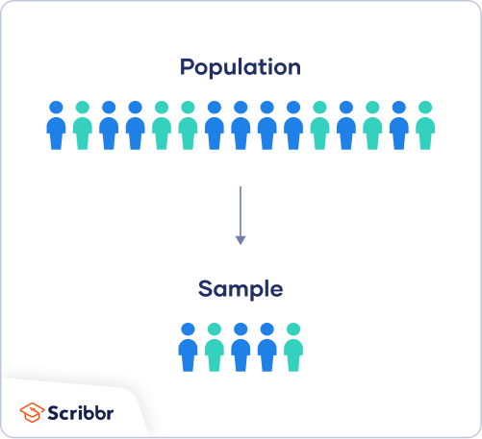
In research, a population doesn’t always refer to people. It can mean a group containing elements of anything you want to study, such as objects, events, organizations, countries, species, organisms, etc.
A population is the entire group that you want to draw conclusions about.
A sample is the specific group that you will collect data from. The size of the sample is always less than the total size of the population.

Slide 7
Reasons for Sampling
Necessity: Sometimes it’s simply not possible to study the whole population due to its size or inaccessibility.
Practicality: It’s easier and more efficient to collect data from a sample.
Cost-effectiveness: There are fewer participant, laboratory, equipment, and researcher costs involved.
Manageability: Storing and running statistical analyses on smaller datasets is easier and reliable.

Slide 8
Types of sampling
Probability sampling involves random selection, allowing you to make strong statistical inferences about the whole group.
Non-probability sampling involves non-random selection based on convenience or other criteria, allowing you to easily collect data.

Slide 9
If you are using a survey that was designed by someone else, state the source of the survey.
Describe the theoretical constructs that the survey is attempting to measure.
Include a copy of the actual survey in the appendix and state that a copy of the survey design is in the appendix.
Other instruments, such as a questionnaire, pro-forma, schedule, consent form etc that were used in the survey to record information,

Slide 10
State exactly when the research will begin and when it will end.
Describe any special procedures that will be followed (e.g. instructions that will be read to participants, presentation of an informed consent form, etc.)
Analysis Plan
The analysis plan should be described in detail. Each research question will usually require its own analysis

